Slide 1
CWS Bat Program
Prepared for:
Migratory Bats National Session
Prepared and Presented by:
Canadian Wildlife Service
Michael Anissimoff
Bethany Thurber
February 2024

Slide 2
Purpose & Outline
Purpose:
Provide overview of the issues, and ECCC’s roles and responsibilities for bat conservation
Outline:
  Bat Basics:
    Bats 101
    Hibernators vs. Migrators
    Canada’s Bats
  The Issues:
    White Nose Syndrome, Wind Turbines, Emerging Zoonoses
  Rationale and Next Steps

Slide 3
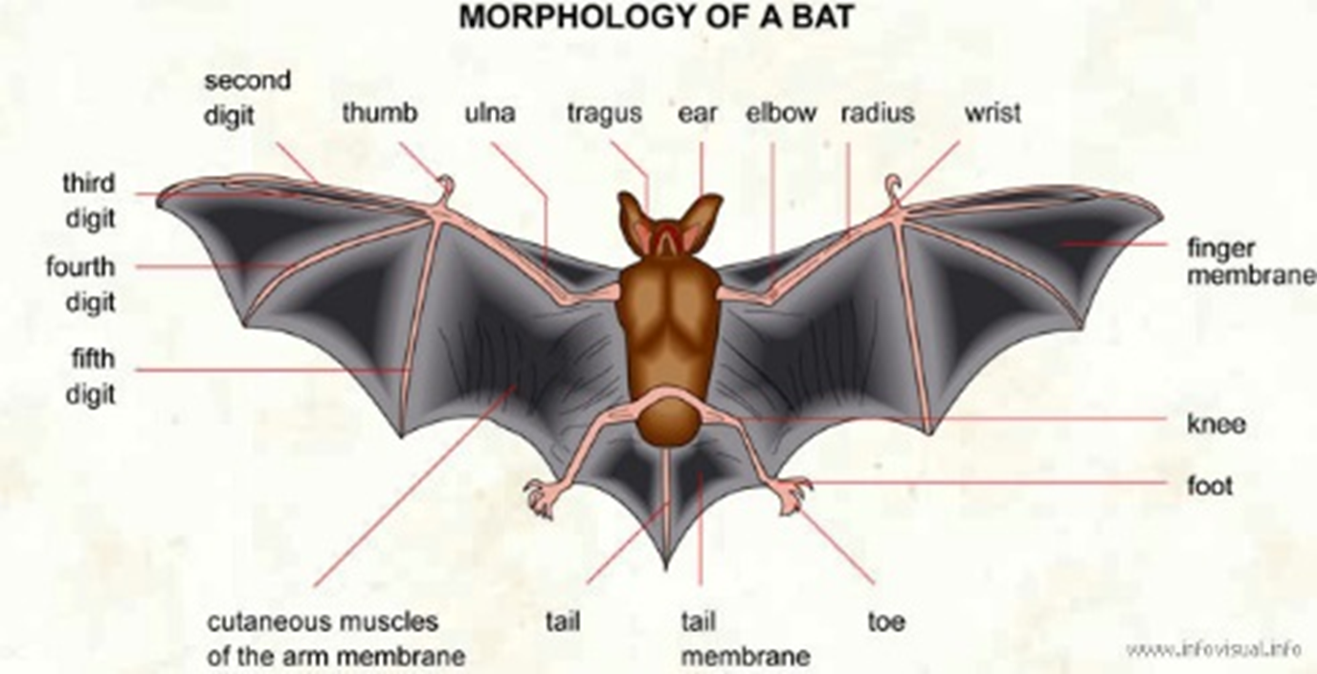
Bat Basics: What is a bat?
Credit: Infovisual.info

Slide 4
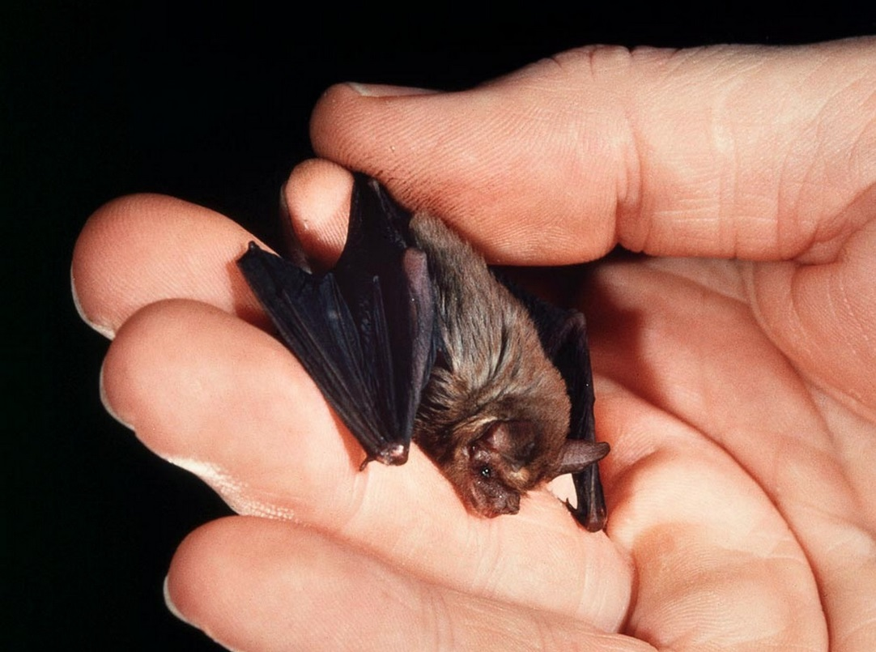
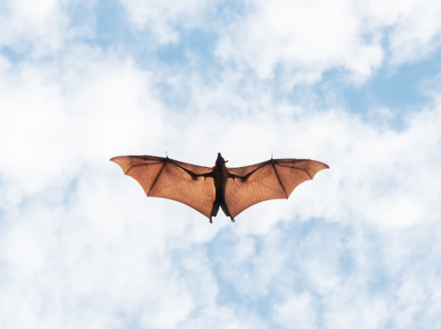
Bat Basics: So many shapes and sizes!
Over 50 million year’s worth of evolution
More than 1400 known bat species and counting
That’s approximately 20% of all known mammal species!
Credit: Merlin D. Tuttle/Science Source
Credit: Ishan@seefromthesky
Notes:
GC:Philippines, BB: Thailand Myanmar

Slide 5
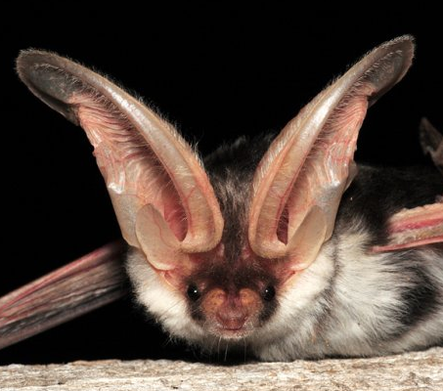
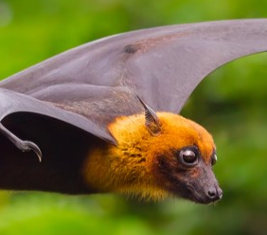
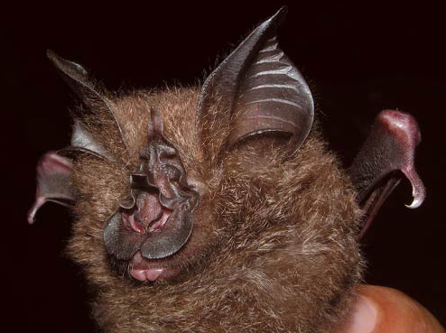
Bat Basics: Why the variation?
Credit: San Diego Zoo
Credit: US Bureau of Land Management
Credit: Natural History Museum, London
Notes:
Question 3: When looking at a bat, one can often surmise what role the bat plays, or the broad geographic location (hemisphere) it may exist
Besides hearing, does anyone know an additional function the EARS provide? Lift
Besides smelling, does anyone know an additional function the NOSE provides? Sound dispersal to the ears, and some bats can even emit sound from their nose.
The name of the newly discovered Rhinolophus species – the Francis’ woolly horseshoe bat (Rhinolophus francisi) – honors Dr Charles M. Francis, a scientist who collected the type specimen of the new species in Malaysia in 1983

Slide 6
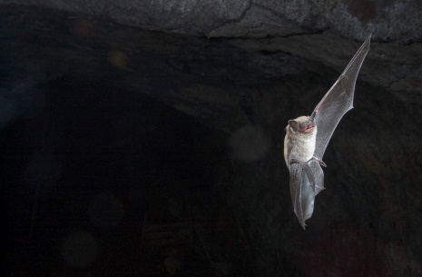
Bat Basics: Canada’s Bats
1400+ species and counting
Ecosystem services (pollination, seed dispersal, insect control)
18 species of bats (that we know of)
All are insectivorous (can eat 1200 mosquitos a night / body weight)
Economic value = $billions
Use echolocation (ultrasonic)
Long-lived (37 years)
High adult survival and low reproductive rate (1 or 2 pups/year)
= susceptible to extinction
World
Canada
Credit: Brock and Sherri Fenton

Slide 7
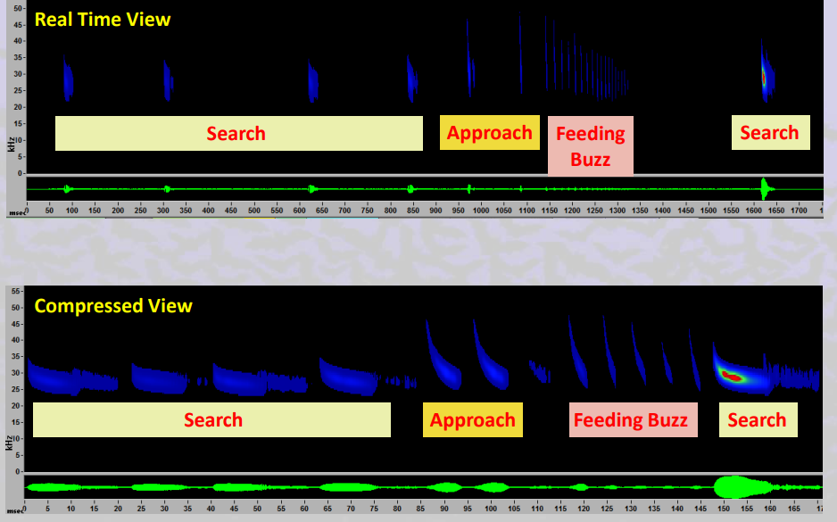
Bat Basics: Echolocation
Credit: Montana Natural Heritage Program

Slide 8
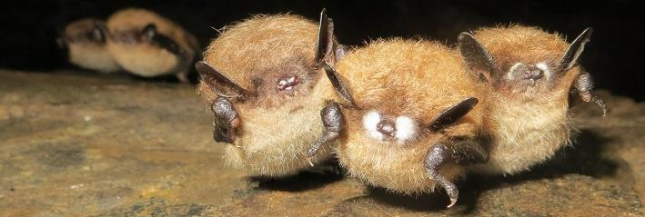
Bat Basics: Migration vs. Hibernation
In Canada, no insects in the winter; bats must migrate south to warmer climates (e.g., USA) or hibernate
  Long-distance migratory bats (tree-roosting bats)
  Short-distance/resident bats hibernate in caves, mines, some in houses
    Microclimate (temperature/humidity) is important
Credit: Hugh Broders

Slide 9
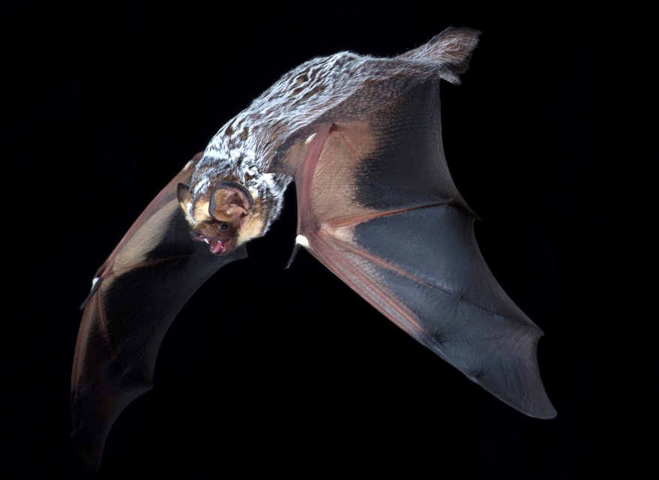
Canada’s Bats: Hoary Bat
The estimate for the Hoary Bat’s annual decrease in numbers is 21%
Credit: Brock and Sherri Fenton
Credit: Brock and Sherri Fenton

Slide 10
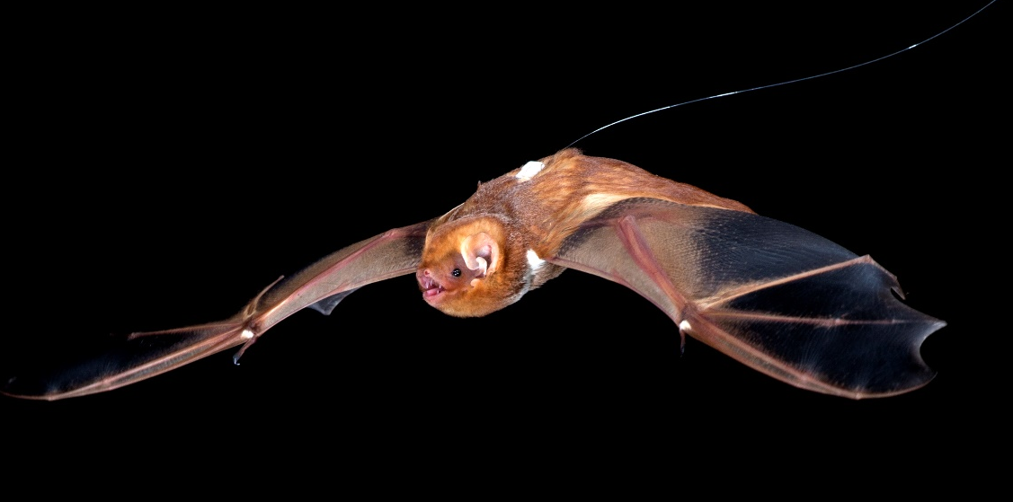
Canada’s Bats: Eastern Red Bat
The estimate for the Eastern Red Bat’s annual decrease in numbers is 27%
Credit: Brock and Sherri Fenton

Slide 11
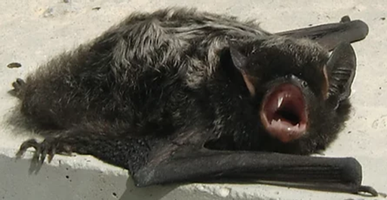
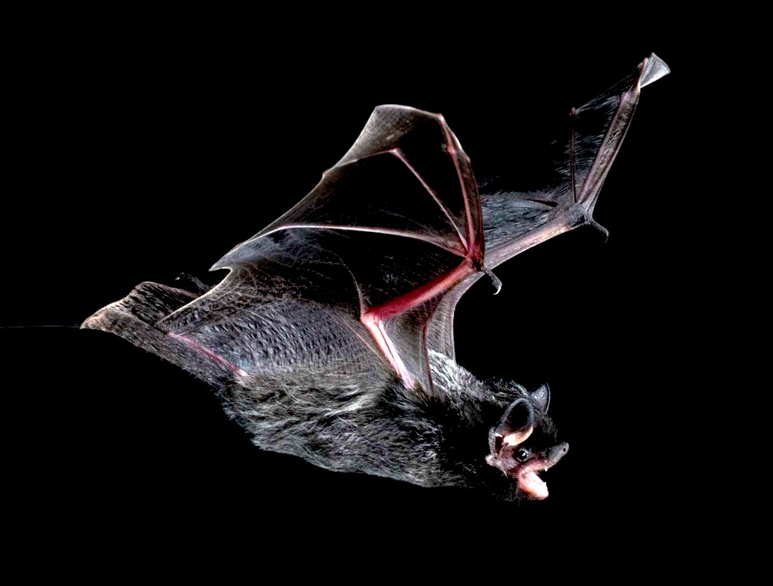
Canada’s Bats: Silver-haired Bat
The estimate for the Silver-haired Bat’s annual decrease in numbers is 29%
Credit: Michael Anissimoff
Credit: Brock and Sherri Fenton
Credit: Brock and Sherri Fenton
Credit: Brock and Sherri Fenton

Slide 12
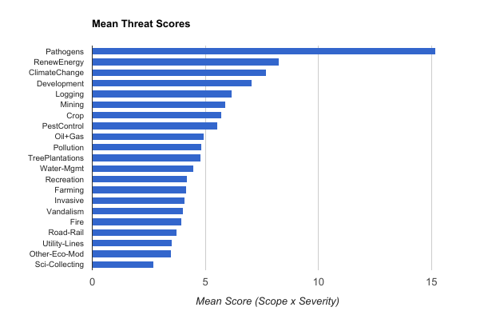
Threats: All bats
Credit: North American Bat Conservation Alliance

Slide 13
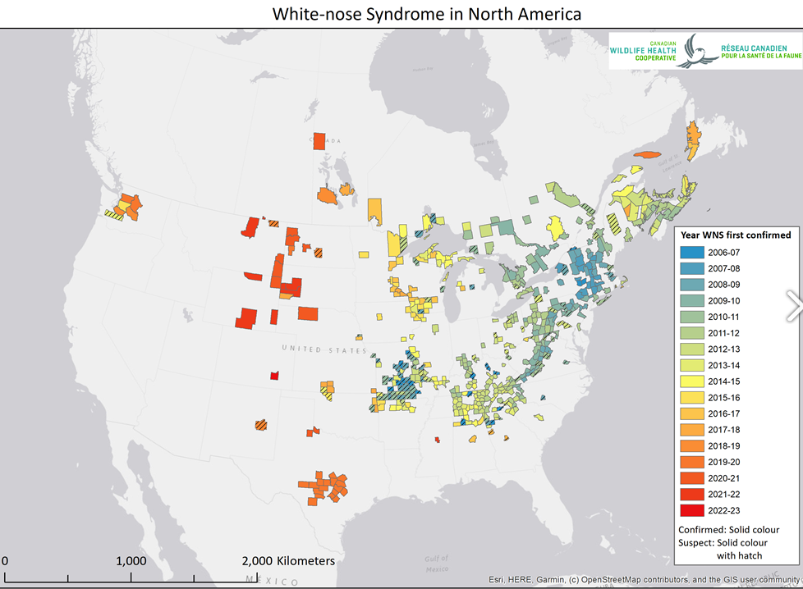
Threats: Hibernators
Three species SARA listed in 2014 under an Emergency Listing Order
The most rapid population decline ever recorded for any animal (95% population reduction in three years)
White-nose Syndrome, caused by: Pseudogymnoascus destructans (Pd), invasive European fungus
Credit: CWHC

Slide 14

Threats: Migratory Bats and Wind Turbines
Turbine related mortality:
  Estimated 166,000 individual bats (all species) per year
  Migratory bats = >75%
  Annual population declines:
  Hoary bat 21%, Eastern Red bat 27%, Silver-haired bat 29%
The wind industry:
  ~7,000 turbines currently installed
  More to be come, including offshore
  Turbines are getting taller and cover a bigger area of the sky:
    Past standard turbines = 50 m blade, windswept area = 4.5 acres
    Future turbines = >100 m blade, windswept area = >10 acres
Taller turbines result in higher bat mortality
Credit: Bethany Thurber

Slide 15
Threats: Migratory Bats and Wind Turbines
Looking forward:
  Population decreases, sky is key habitat for foraging/migrating + more, larger turbines = how to address the threat?
Solution: Mitigation or “operational curtailment” effectively reduces mortality
  Operational curtailment = turbine blades do not spin when mortality risks are highest
  Different approaches in each province/territory; usually on late summer/fall nights when wind speeds are slow
  New “on-demand” approach can reduce mortality by 90%: turbine operations curtailed ONLY when bats are present
Energy supply and financial implications (Ontario focus) :
  Annual reduction in energy production = 0.42% vs other sources of loss = >16%
  Estimated profit loss for all wind producers = $6.79 million VS. estimated earnings = $1.6 billion

Slide 16
Threats: Pathogens
Pathogens in Bat Guano
Canada imported ~500,000kg of bat guano (2008-2014), 95% went to Grand Forks BC for cannabis production
53 pathogens (Bacteria, virus, fungi) found in bat guano
  92% are present in Canada
  96% are a threat to wildlife
  88% are a threat to human health
Fig. 1 Bat guano microbiome—a silent life-threatening pathogenic bacteria and epidemic/pandemic of fungal and viral diseases
Dimkić et al. (2021)

Slide 17
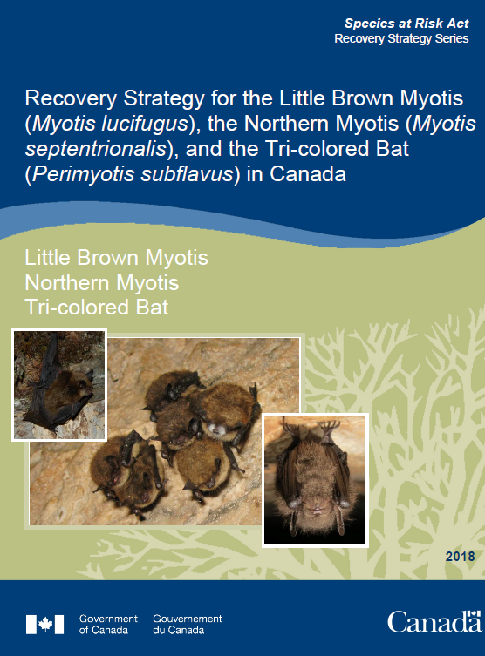
Rationale and Next Steps
For Listed Bats (Non-migratory), ECCC is working to:
Identify and protect important roosts: maternity roosts and hibernacula and biophysical attributes
Conduct annual surveillance to understand abundance, distribution, and movement
Continue surveillance of WNS, and other pathogenic threats (viruses, bacteria, fungi), in a One Health context
For Migratory Bats, ECCC is working to:
2023 COSEWIC Assessment
Beneficial Management Practices for wind energy
Notes:
GOAL:
Increase survivability of reproductive adults
Identify where bats concentrate and why (i.e., maternity roosts)

Slide 18
Thank you for your time and participation!
Please reach out, we love talking bats!!!
Michael.Anissimoff@ec.gc.ca
Bethany.Thurber@ec.gc.ca

