Slide 1
GREETINGS
WELCOME TO THE MIGRATORY BATS SESSION
We invite you to put your Name and Nation/Organization into the chat while we wait for others to join.
Silver-haired Bat
Photo: © Brock and Sherri Fenton
Hoary Bat
Photo: © Brock and Sherri Fenton
Eastern Red Bat
Photo: © Brock and Sherri Fenton
WE HOPE TODAY CAN BE A DAY OF SHARING TO PROMOTE BAT CONSERVATION
Simultaneous French translation will be provided
Indigenous research into little brown bats aims to help species survive | CBC News
"They're very good … The little brown bat can eat 50 per cent [or more] of its own weight in insects and pests like mosquitos at night ....so we feel there is a use for them here.“
Wahnapitae First Nation- Anthony LaForge

Slide 2
Environment and climate change Canada- Canadian wildlife service
National Workshop the Potential listing of 3 Migratory Bats under the federal Species at Risk Act
Wendy Eskowich Michael Anissimoff Bethany Thurber
ECCC - Canadian Wildlife Service
February 20 & 28, 2024
Guest Presenter: Steven Kell

Slide 3
Why Are We Here Today?
Listing Process - Context: The Species at Risk Act (SARA)
to share information about the potential addition or “listing” of three migratory bats to Schedule 1 of SARA, and what that might mean to you
to provide an opportunity to submit comments on potential social or economic impacts (if the bats were to be listed), to help inform the Minister’s recommendation on whether to List bats or not.
Bat Conservation & Recovery Planning
to share information on CWS Bat program, why bats are at risk
Indigenous teaching about bats
Discuss ways to work together to help these imperiled bats
Hoary Bat
Silver-haired Bat
Eastern Red Bat
Photos: © Brock and Sherri Fenton

Slide 4
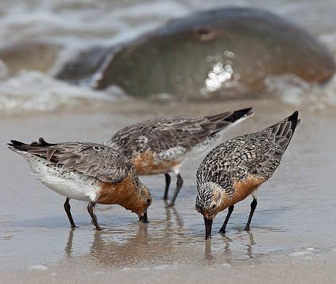
What is a “Species at Risk” ?
Species – (terrestrial) plant or animal
At risk = a possibility, or “some risk”, that the species may disappear from the wild in Canada,
Red Knot
© Jan van de Kam
unless the (man-made) threats that are causing the decline in numbers, are removed or reversed.

Slide 5
Status Categories for Species at Risk
Extinct No longer exists anywhere in the world
Extirpated
No longer exists in the wild in Canada
Facing imminent extirpation or extinction (close to disappearing from Canada)
Endangered
Threatened
Likely to become endangered unless threats are removed
May become threatened or endangered because it is sensitive to human activities or natural events
Special Concern
NOT AT RISK or No longer at Risk

Slide 6
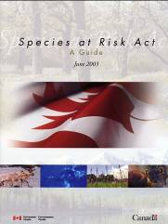
What is the Species at Risk Act ?
A national (federal) approach for conservation of species that may be at risk of disappearing in the wild in Canada
The purpose of the federal Species at Risk Act (SARA) is to:
prevent species from becoming extinct by protecting individuals and their habitat
recover species that are endangered or threatened as a result of human activity and/or developments
work in a complimentary fashion with provincial legislation.

Slide 7
SARA Recognizes Indigenous Rights
SARA respects the protection of Indigenous rights, as affirmed in the Constitution
Canadian Constitution (Section 35): “The existing aboriginal and treaty rights of the aboriginal peoples of Canada are hereby recognized and affirmed.”
SARA (Section 3): “For greater certainty, nothing in this Act shall be construed so as to abrogate or derogate from the protection provided for Aboriginal or Treaty rights of the Aboriginal peoples of Canada…”

Slide 8
SARA Recognizes Indigenous ROLES IN CONSERVATION ARE ESSENTIAL
Recognizes that:
“the roles of the Aboriginal peoples of Canada and of wildlife management boards established under land claims agreements in the conservation of wildlife in this country are essential,”
and that:
“the traditional knowledge of the Aboriginal peoples of Canada should be considered in the assessment of which species may be at risk and in developing and implementing recovery measures”

Slide 9
The Species at Risk Act Process
Species are re-assessed every 10 years
Evaluation & Reassessment
Assessment
Listing
Recovery Planning
COSEWIC (Independent body of experts) sends species assessment and recommendation to Minister of ECCC to List
Minister’s recommendation to Cabinet
Decision on listing is made by Cabinet
If listed, SARA and prohibitions apply right away
General prohibitions
Recovery Planning starts
Implementation
SARA says: “Plans must be developed”
Draft Recovery Strategy/ Action Plan
Recovery Document CONSULTATIONS
Critical Habitat Identification
Undertake conservation measures described in the plans
Protect Critical Habitat
Pre-listing Consultations
Invite comments on possible social & economic impacts and benefits IF listing were to occur
Comments inform the Minister’s recommendation to LIST, NOT List or send back to COSEWIC for more information.
We are here

Slide 10
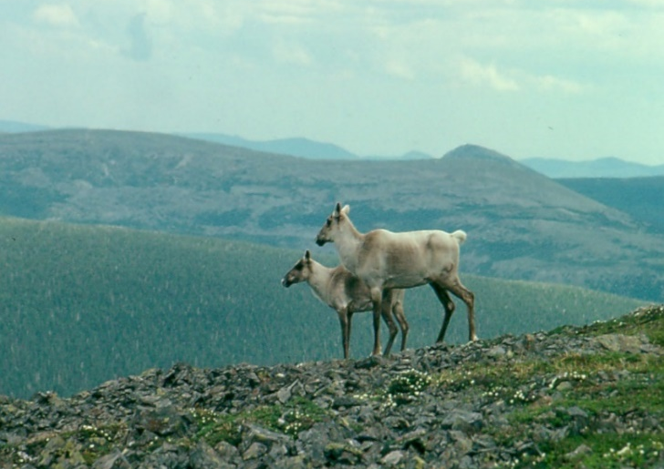
Assessment: Committee on the Status of Endangered Wildlife in Canada (COSEWIC)
Independent group of experts who assess the risk of species’ extinction in Canada, and assign a status
- consider the entire species’ population across Canada (or a Designated Unit of it)
Assessments are based on:
Quantitative criteria set out by the IUCN
(International Union for Conservation of Nature)
  is the population declining;
  is the range shrinking;
  are there major new threats
Scientific knowledge, community knowledge and Aboriginal Traditional Knowledge (ATK)
© Benoit Fontaine
For more info on COSEWIC, Assessment or the ATK subcommittee visit: https://cosewic.ca/index.php/en/assessment-process.html

Slide 11
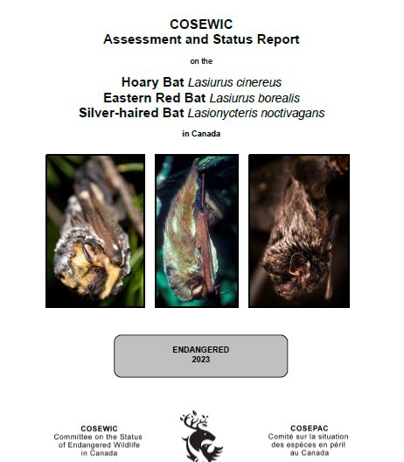
ASSESSMENT OF 3 MIGRATORY BATS
Extinct No longer exists in the world
No longer exists in the wild in Canada
Extirpated
Facing imminent extirpation or extinction
Endangered
Threatened
Special Concern
NOT AT RISK
or No longer at Risk
https://wildlife-species.az.ec.gc.ca/species-risk-registry/virtual_sara/files//cosewic/sr-HoaryEasternRedSilverHairedBats-v00-Nov2023-eng.pdf

Slide 12
The Species at Risk Act Process
Species are re-assessed every 10 years
Evaluation & Reassessment
Assessment
Listing
Recovery Planning
COSEWIC (Independent body of experts) sends species assessment and recommendation to Minister of ECCC to List
Minister’s recommendation to Cabinet
Decision on listing is made by Cabinet
If listed, SARA and prohibitions apply right away
General prohibitions
Recovery Planning starts
Implementation
SARA says: “Plans must be developed”
Draft Recovery Strategy/ Action Plan
Recovery Document CONSULTATIONS
Critical Habitat Identification
Undertake conservation measures described in the plans
Protect Critical Habitat
Pre-listing Consultations
Invite comments on possible social & economic impacts and benefits IF listing were to occur
Comments inform the Minister’s recommendation to LIST, NOT List or send back to COSEWIC for more information.
Consult with provinces, territories, Indigenous peoples, interested groups and stakeholders
“normal” period is 3-4 months
“extended process” for species requiring more consultation and analysis (9 months)
BATS – severe and rapid decline in numbers; started consultations early, to be completed by May 16, 2024.
We are here

Slide 13
BAT Consultation NOTIFICATION
  When: December 2023
  What: Email/Mail from each CWS region
    Subject: Seeking comments on the Potential Amendment to Schedule 1 of the Species at Risk Act: Migratory Bats
      Fact sheets about each of the three migratory bats
      Consultation Booklet :
        -Explains the Listing process, questions to guide your comments
      Comment period is open until May 16, 2024
How: Send comments by email to SARAregistry@ec.gc.ca , or by mail
Today – if you wish to submit comments on the potential listing
Why: To help inform the Minister’s recommendation to List or not List;
by indicating possible impacts to you or your community, and to help inform future recovery planning and conservation processes for these imperiled bats.

Slide 14
The Species at Risk Act Process
Species are re-assessed every 10 years
Evaluation & Reassessment
Assessment
Listing
Recovery Planning
COSEWIC (Independent body of experts) sends species assessment and recommendation to Minister of ECCC to List
Minister’s recommendation to Cabinet
Decision on listing is made by Cabinet
If listed, SARA and prohibitions apply right away
General prohibitions
Recovery Planning starts
Implementation
SARA says: “Plans must be developed”
Draft Recovery Strategy/ Action Plan
Recovery Document CONSULTATIONS
Critical Habitat Identification
Undertake conservation measures described in the plans
Protect Critical Habitat
Pre-listing Consultations
Invite comments on possible social & economic impacts and benefits IF listing were to occur
Comments are part of the RIAS and inform the Minister’s recommendation to LIST, NOT List or send back to COSEWIC for more information.

Slide 15
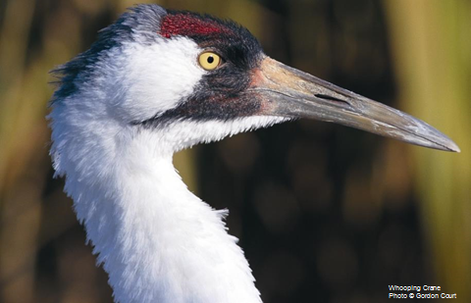
GENERAL PROHIBITIONS
Certain protections are triggered when a species is listed under SARA:
“General prohibitions” -for Extirpated, Endangered & Threatened species: No person shall:
  kill, harm, harass, capture or take an individual
  possess, collect, buy, sell or trade an individual, or any part or derivative
  damage or destroy the residence of one or more individuals
General Prohibitions only apply automatically:
  on all federal lands in a province
  in territories, apply only on lands under the authority
  of ECCC or Parks Canada Agency
  to aquatic species anywhere they occur.
  to migratory birds protected under the MBCA 1994 anywhere they occur
BATS: on non-federal lands, the Minister must form an opinion on whether the P/T laws provide effective protection of individuals & residences

Slide 16
The Species at Risk Act Process
Species are re-assessed every 10 years
Evaluation & Reassessment
Assessment
Listing
Recovery Planning
COSEWIC (Independent body of experts) sends species assessment and recommendation to Minister of ECCC to List
Minister’s recommendation to Cabinet
Decision on listing is made by Cabinet
If listed, SARA and prohibitions apply right away
General prohibitions
Recovery Planning starts
Implementation
SARA says: “Plans must be developed”
Draft Recovery Strategy/ Action Plan
Recovery Document CONSULTATIONS
Critical Habitat Identification
Undertake conservation measures described in the plans
Protect Critical Habitat
Pre-listing Consultations
Invite comments on possible social & economic impacts and benefits IF listing were to occur
Comments are part of the RIAS and inform the Minister’s recommendation to LIST, NOT List or send back to COSEWIC for more information.

Slide 17
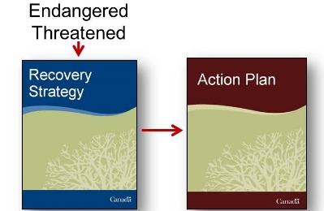
Recovery Planning for BATS
If the 3 migratory bats are Listed under SARA as endangered a recovery strategy will be written within a mandated timeframe:
  1 year for endangered species
  followed by an Action Plan
  include identification of critical habitat
Recovery Strategy must be prepared in consultation and cooperation with potentially impacted Indigenous organizations
Purpose:
  To gather information to inform strategies/ plans for recovery
  To avoid or minimize impact on Aboriginal rights
  To engage Indigenous peoples in recovery implementation

Slide 18
The Species at Risk Act Process
Species are re-assessed every 10 years
Evaluation & Reassessment
Assessment
Listing
Recovery Planning
COSEWIC (Independent body of experts) sends species assessment and recommendation to Minister of ECCC to List
Minister’s recommendation to Cabinet
Decision on listing is made by Cabinet
If listed, SARA and prohibitions apply right away
General prohibitions
Recovery Planning starts
Implementation
SARA says: “Plans must be developed”
Draft Recovery Strategy/ Action Plan
Recovery Document CONSULTATIONS
Critical Habitat Identification
Undertake conservation measures described in the plans
Protect Critical Habitat
Pre-listing Consultations
Invite comments on possible social & economic impacts and benefits IF listing were to occur
Comments are part of the RIAS and inform the Minister’s recommendation to LIST, NOT List or send back to COSEWIC for more information.

Slide 19
Listing: Areas of Focus
Supporting meaningful involvement in SARA listing decision
When deciding whether to list these bats, the Minister considers:
  Recommendations from COSEWIC and the Aboriginal Traditional Knowledge sub-committee
  If the bats support any livelihoods? (e.g. through harvesting, subsistence or medicine)
  Are there any potential cultural, social, or economic costs/impacts to individual, community or organizational activities if bats are listed?
  Are there any current, or planned, activities that overlap with the bats’ range and that may harm them and/or destroy their habitat?
  Any other information people choose to share during consultation

Slide 20
bats
Mike Anissimoff & Bethany Thurber – CWS Bat Program
Steven Kell - Indigenous teaching on bats:
Discussion and sharing on:
    potential impacts of listing: comments
    interest in bat recovery planning
    Q & A

Slide 21
Discussion & Questions to guide your comments on the potential listing
Do bats provide cultural/spiritual/social benefits, and would these be impacted if the 3 migratory bats are listed, or not listed?
Do bats provide environmental benefits, and would these be impacted if the 3 migratory bats are listed, or not listed?
Would there be any economic impacts to individuals or communities if the 3 migratory bats are listed, or not listed?
Are there any other potential impacts (or benefits), if the 3 migratory bats are listed, or not listed?

Slide 22
Discussion & Questions on:
RECOVERY PLANNING
Are there any specific threats for the 3 migratory bat species in your community/territory that have not been identified?
What conservation actions do you think are necessary to recover these 3 migratory bat species?
If the 3 migratory bats are listed, how would you like to be involved in the development of a future Recovery Strategy for them?

Slide 23
Eccc - cws regional staff
PACIFIC REGION
Undine Thompson-Sr Consultation & Recovery Integration Biologist
Undine.Thompson@ec.gc.ca
Arran Gregory – Sr Program Delivery Officer
Arran.Gregory@ec.gc.ca
ONTARIO REGION
Christina Rohe – Consultations Biologist
Christina.Rohe@ec.gc.ca
Jessica Harriott- Wildlife Biologist
Jessica.Harriott@ec.gc.ca
NORTHERN REGION –YT, NWT, NU
Rhiannon Pankratz – Northern Liaison Biologist
Rhiannon.Pankratz@ec.gc.ca
QUEBEC REGION
Andree-Anne Vezina – Indigenous Liaison
AndreeAnne.Vezina@ec.gc.ca
Marie-Hélène Dickey – Indigenous Coordination & Consultation Officer
Marie-Helene.Dickey@ec.gc.ca
ATLANTIC REGION
Lauren Pitre- Consultation Biologist
Lauren.Pitre@ec.gc.ca
PRAIRIE REGION – AB, SK & MB
SARA-CCA
Rebecca McKay- Indigenous Relations Policy Advisor
Rebecca.McKay@ec.gc.ca
Natalie Fondren-Gasc – Program Officer
Natalie.Fondren-Gasc@ec.gc.ca
PRAIRIE REGION
SPECIES AT RISK RECOVERY UNIT
Paulson Des Brisay – Senior Wildlife Biologist
Paulson.DesBrisay@ec.gc.ca
Kaytlyn Burrows Kalenchuk
Consultation Biologist
Kaytlyn.BurrowsKalenchuk@ec.gc.ca
THANK YOU!

