Slide 1
Wolverine workshop
EARLY ENGAGEMENT session on wolverine in Ontario and DRAFTING OF THE FEDERAL MANAGEMENT PLAn
Presented by: Christina Rohe, Kate O’Donoghue
JULY 12, 2023

Slide 4
Agenda
Introductions
Species at Risk Act consultation, cooperation and accommodation project (SARA-CCA)
Purpose of today’s Workshop
SARA Listing and requirements of a management plan
Options to be involved in developing the federal management plan
How to navigate the Species at Risk Public Registry website
Presentation from Matthew Scrafford, Wildlife Conservation Society of Canada
Short Break
Series of Questions to Guide Knowledge Sharing
Closing

Slide 5
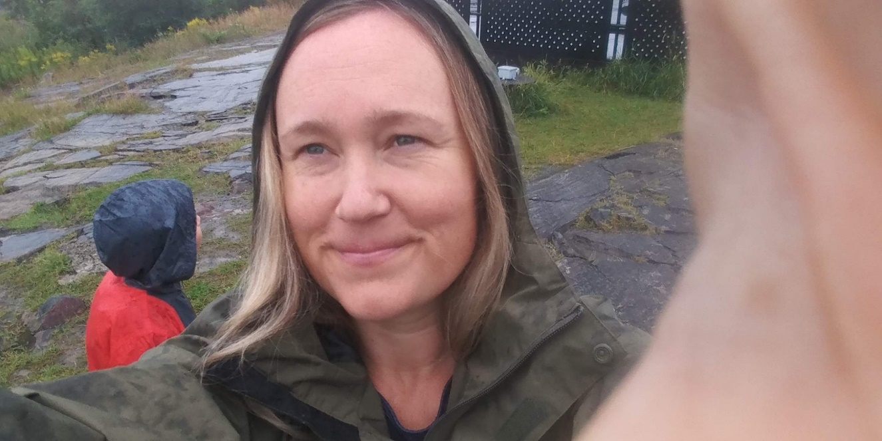
Who Am I
Christina Rohe
(aka ‘Chris’)
A/ Consultation Biologist (Fall 2022 – Present)
Canadian Wildlife Service, Ontario Region
(2009 – Present)
These are a few of my favourite things… kayaking, hiking, snowshoeing, cooking, gardening, cycling, time spent with my parents and sons, bees in my garden, the smell of tomatoes on the vine, being by the water, exploring forests, remoteness, the colours yellow, red and orange, observing animal behavior, snow falls, travelling with my husband (also a ‘Chris’ ☺), meals shared with family and friends

Slide 6
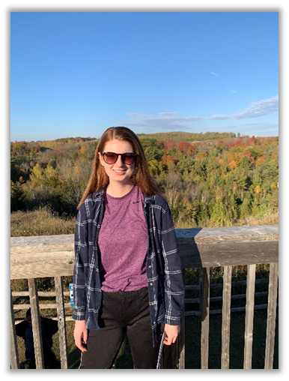
Kate O’Donoghue
Consultation Program Officer
Canadian Wildlife Service, Ontario Region
(2020-present)
These are a few of my favourite things…
canoeing and kayaking (anything on the water!), camping, exploring the Lake Ontario waterfront, spending time with family and friends, identifying and recording observations of wildlife, photography, live music and travelling when I can.

Slide 7
Centre for Indigenous environmental resources (cIER) – Canadian wildlife service (cWS), Species at Risk act (SARA) consultation, cooperation and accommodation project (CCA)
SARACCA project helps facilitate Indigenous communities’ and organizations’ participation in Environment and Climate Change Canada’s (ECCC) listing and recovery planning processes for terrestrial species. Website: https://yourcier.org/sara/ontario/

Slide 8
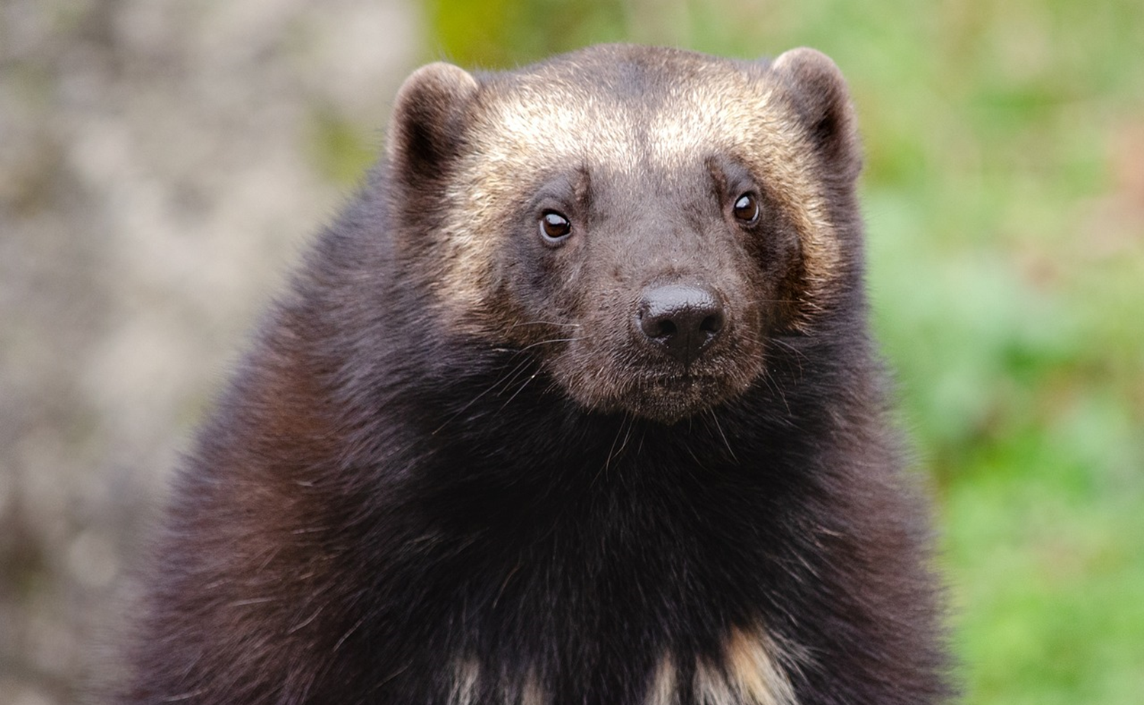
Purpose of this workshop
Strengthen our relationships through Listening,
Learning and Sharing different knowledge
about Wolverine – a species at risk
This is a National approach for early engagement
to cooperatively develop the federal
Management Plan for Wolverine (Gulo gulo)
in Canada
Management Plans can help a species from
disappearing from the wild by identifying key
habitat needs, threats to its persistence and
setting goals and conservation actions

Slide 9
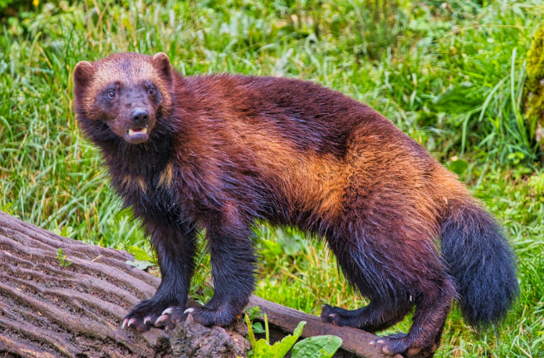
COSEWIC Assessment and listing
Wolverine was assessed as Special Concern by COSEWIC (2014)
Wolverine was added to Schedule 1 of the Species at Risk Act as Special Concern (2018)

Slide 10
Drafting a Federal Management plan
A federal Management Plan is required for species listed as Special Concern
Management Plan
Sections of a Management Plan (MP):
Species Description
Species Population and Distribution
Species habitat needs/Limiting factors
Threats to the species survival / recovery
Management objective
Broad strategies and conservation measures
Measuring progress
Effects the recommended actions outlined in the MP may have on the environment and other species

Slide 11
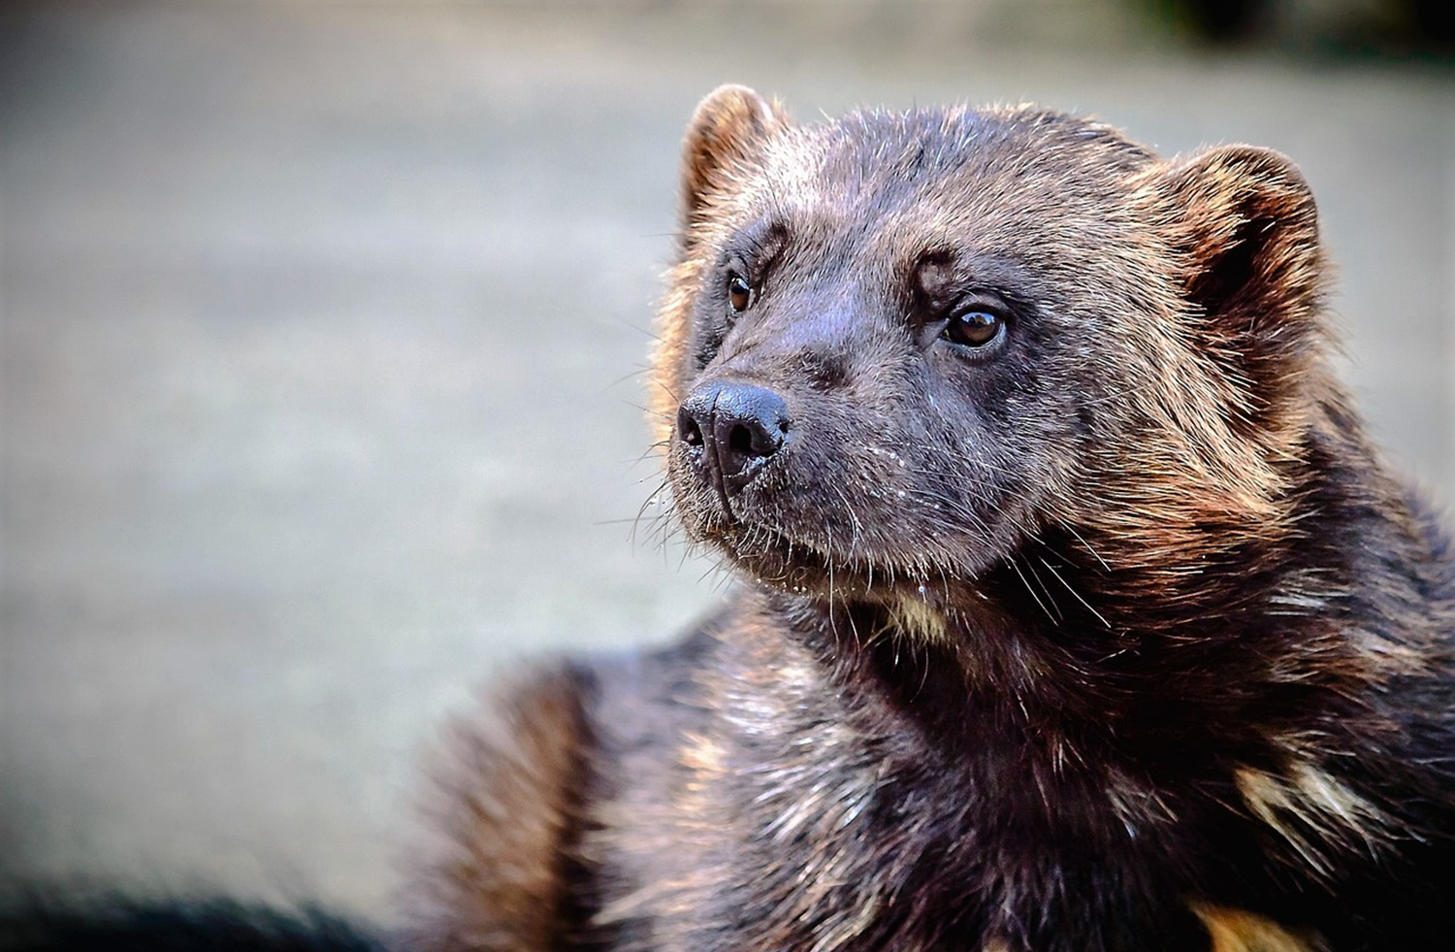
Sharing Indigenous knowledge
IF you are interested, there are many opportunities to contribute to the management plan and options for how you would like the information to be acknowledged:
Examples for how to contribute information
Information can be provided today during this workshop
Information can be provided following the workshop (email)
Information can be provided during jurisdictional review
Information can be provided when the document is posted as proposed on the SAR Public Registry
Examples for how information can be acknowledged
As an individual
On behalf of your First Nation / Indigenous Organization
Anonymous and under the umbrella of ‘information shared during the July 2023 wolverine workshop’
*Please Note the Management Plan for Wolverine (Gulo gulo) in Canada will eventually be posted on the Species at Risk (SAR) Public Registry

Slide 12
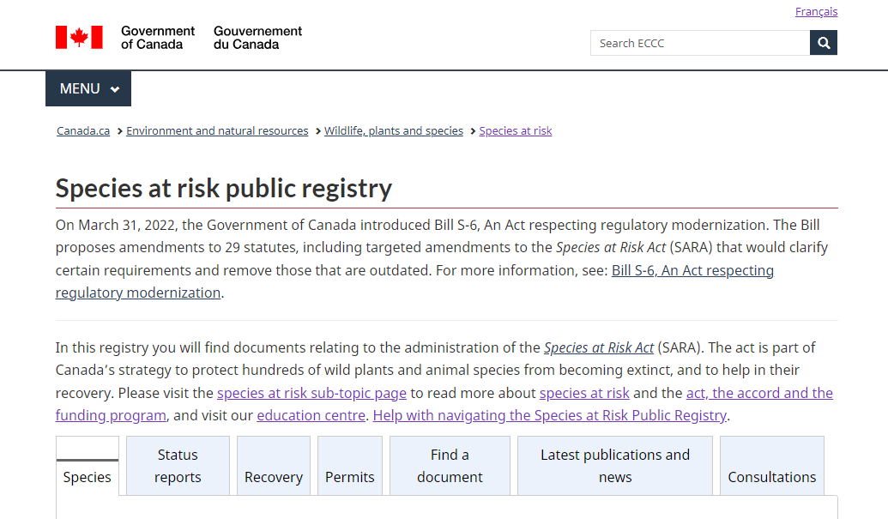
Brief Virtual ‘live’ tour of the SAR Public registry
Navigating to and navigating
around the Species at Risk (SAR)
Public Registry
SAR Public Registry:
https://www.canada.ca/en/environment-climate-change/services/species-risk-public-registry.html
Notes:
Pause and go to live tour with LM

Slide 13
Notes:
Slide is a Placeholder – This is when Matt will start his presentation

Slide 14
upcoming after the break- Series of Questions to Guide Knowledge Sharing
Short Break
Are you seeing wolverine in new areas then historically?
Do you think the number of wolverines in Ontario are increasing or decreasing?
Have you noticed any changes in wolverine habitat use or diet?
What actions do you think should be recommend to support wolverine conservation?
Do you think climate change will have impacts on wolverines in Ontario?
Questions or Anything else to share?

Slide 15
For More Information…
If you have questions, or would like to receive more information, please contact us:
Chris Rohe
Christina.Rohe@ec.gc.ca
A/Consultations Biologist
ECCC, CWS- Ontario Region
Kate O’Donoghue
Kate.Odonoghue2@ec.gc.ca
Consultations Officer
ECCC, CWS - Ontario Region

Slide 16
How the different types of funding work

Slide 17
Capacity Funding
Funding to support participation in species-specific workshops and/or meetings organized by CIER/ECCC
To provide funding for community members, staff, elders, and knowledge holders to share their time and cover in-person meeting expenses.
Funding amounts are based on Treasury Board of Canada rates. Details on available funding will be provided in individual session invitations.
Process
A community contact or ECCC will be asked to provide requested information to CIER by email.
CIER will mail a cheque within 3 weeks of the session to the community contact who is responsible for distributing the funds to participants.
Notes:
This is ongoing support for meetings.

Slide 18
Capacity Funding
2. Capacity funding to support information sharing for federal terrestrial species at risk listing and recovery planning
To help address possible capacity challenges and work better together, ECCC is partnering with CIER who will administer federal capacity funding for those wishing to share data, knowledge and other information with ECCC about terrestrial species at risk but need some support to do so.
Also, if those sharing information wish to formalize how this is done, ECCC is open to exploring approaches that can work for everyone (e.g., MOUs, protocol agreements, data sharing agreements).
Notes:
Environment and Climate Change Canada (ECCC) has heard from many Indigenous communities and organizations that they wish to collect information and share it with ECCC so they can contribute meaningfully to SARA listing decisions, work together to develop recovery documents, and review and provide input to draft recovery documents before they are finalized and posted online. However, while some have sufficient capacity to do this, others do not.

Slide 19
Capacity Funding
Funding can support honorariums, travel, room rental, hospitality, professional services, Indigenous Knowledge collection, document review and written comments. The Treasury Board of Canada rates will apply.
Process
Community/organization will fill in the Capacity Funding Request form and submit to CIER prior to undertaking activities.
Upon review and approval, CIER will mail a cheque within 3 weeks to the applicant who is responsible for distributing the funds to participants.
Notes:
Capacity requests are ongoing.
To be asked for in advance of a meeting.

Slide 20
Expression of Interest
Expression of Interest
To provide federal funding, administered by CIER, to support as many targeted short-term activities that will help with terrestrial species at risk (SAR) recovery actions, address immediate threats to SAR, and provide information that will fill knowledge gaps in listing considerations and recovery document development for specific species.
Projects can include any SARA listed terrestrial Species at Risk, priority will be given to proposals focusing on the species undergoing listing consultation and recovery planning within the next two years.
Should funds allow, additional calls for expressions of interest may be made later in the year.
Project amounts up to $15,000.
Notes:
Environment and Climate Change Canada (ECCC) has heard from many Indigenous communities and organizations that they wish to undertake targeted short-term activities that will help with terrestrial species at risk (SAR) recovery actions, address immediate threats to SAR, and provide information that will fill knowledge gaps in listing considerations and recovery document development for specific species.
To fund projects that directly support Indigenous peoples’ and organizations’ meaningful participation in listing consultations and recovery planning for terrestrial Species at Risk.
-Competitive process
-CIER can support with applications by contacting the CIER staff listed in the EOI template for your region.
-Through this process we will try to fund as many as possible

Slide 21
Thank you / Miigwech
Lynn Mallett - ON Lead
CIER Project Manager
lmallett@yourcier.org
https://yourcier.org/

