Slide 1
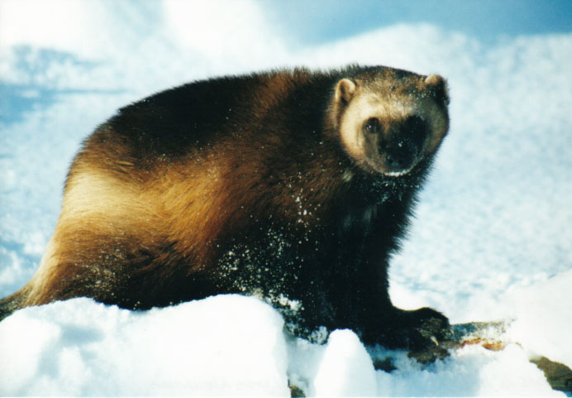
Development of the Management Plan for Wolverine in Canada: Workshop
GNWT
April 4, 2023

Slide 2
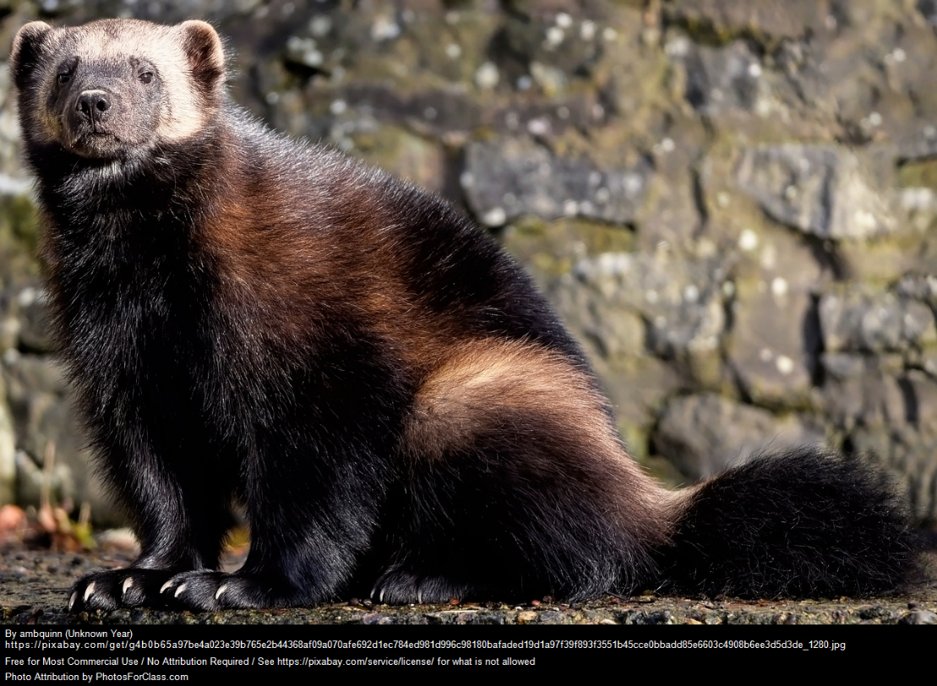
Purpose of this workshop
Share the information CWS has on Wolverine
Seek feedback and input from partners on specific sections of the management plan
Provide a forum where people can discuss Wolverine and share stories and information

Slide 3
Part 1: Introduction: The Federal Species at Risk Act and Wolverine

Slide 4

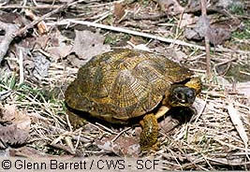
What is a Species at Risk?
Plants and animals that are in danger of disappearing from the wild in Canada
Special Concern
Threatened
Endangered
GNWT
SPECIAL CONCERN
THREATENED
ENDANGERED
EXTIRPATED
EXTINCT
Likely to become Endangered or Threatened unless threats are mitigated.
Likely to become Endangered unless threats are addressed.
No longer exists in the wild in Canada, but exists elsewhere.
Facing imminent disappearance from Canada.
No longer exists anywhere in the world.

Slide 5
Species at Risk Act (SARA)
Purpose
Federal legislation to prevent wildlife from disappearing from Canada
Coordinate conservation efforts on national scale
The Act requires that:
Traditional knowledge be taken into account in the assessment, planning and implementation process
Recovery documents be prepared with the participation of Indigenous communities and organizations that are directly affected and wildlife management boards;
Consultations be held with those directly affected before decisions are made that could impact them

Slide 6
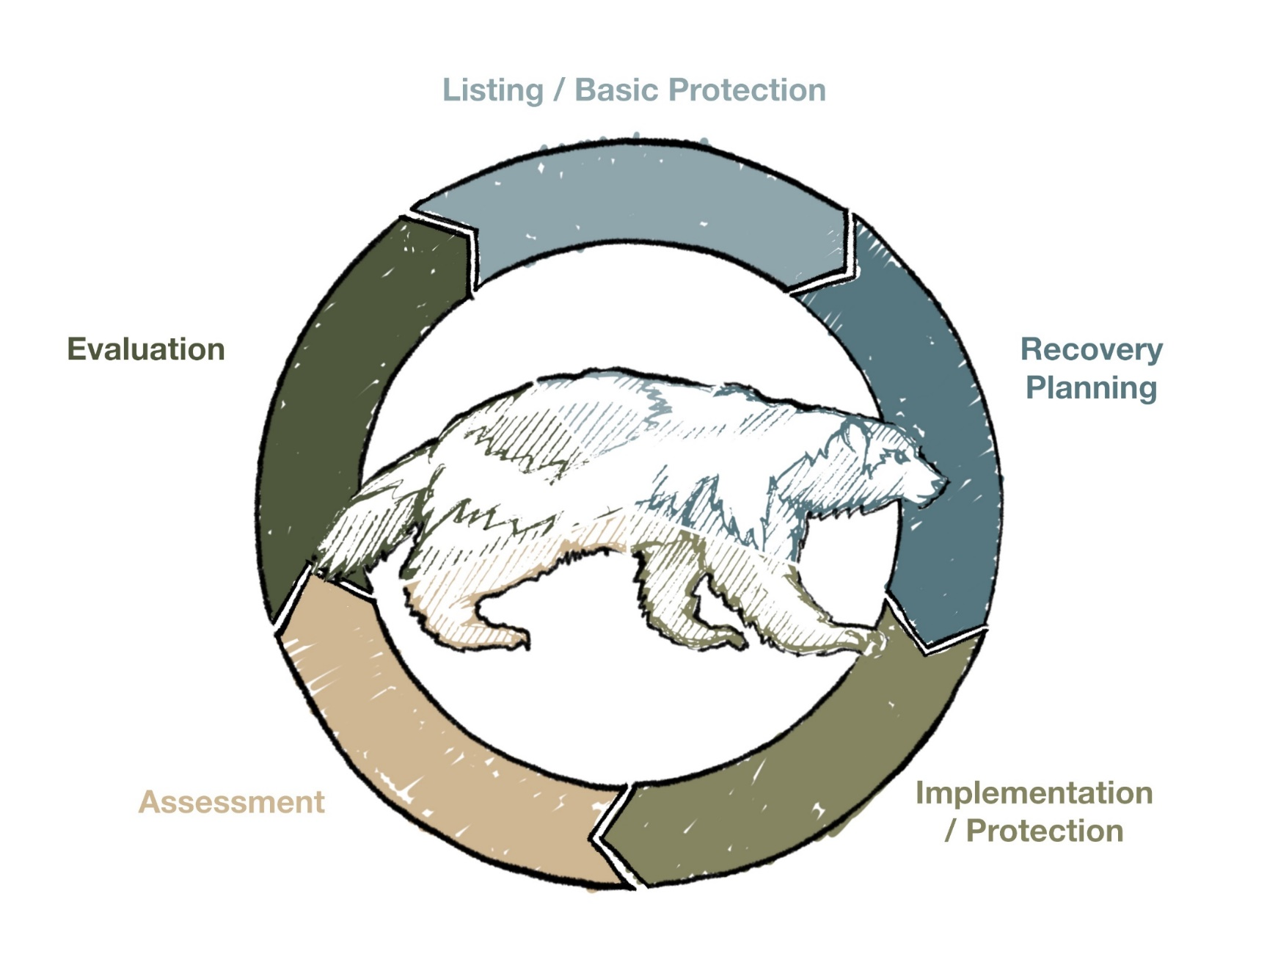
Species at Risk Act (SARA)
Assessment
Evaluation

Slide 7
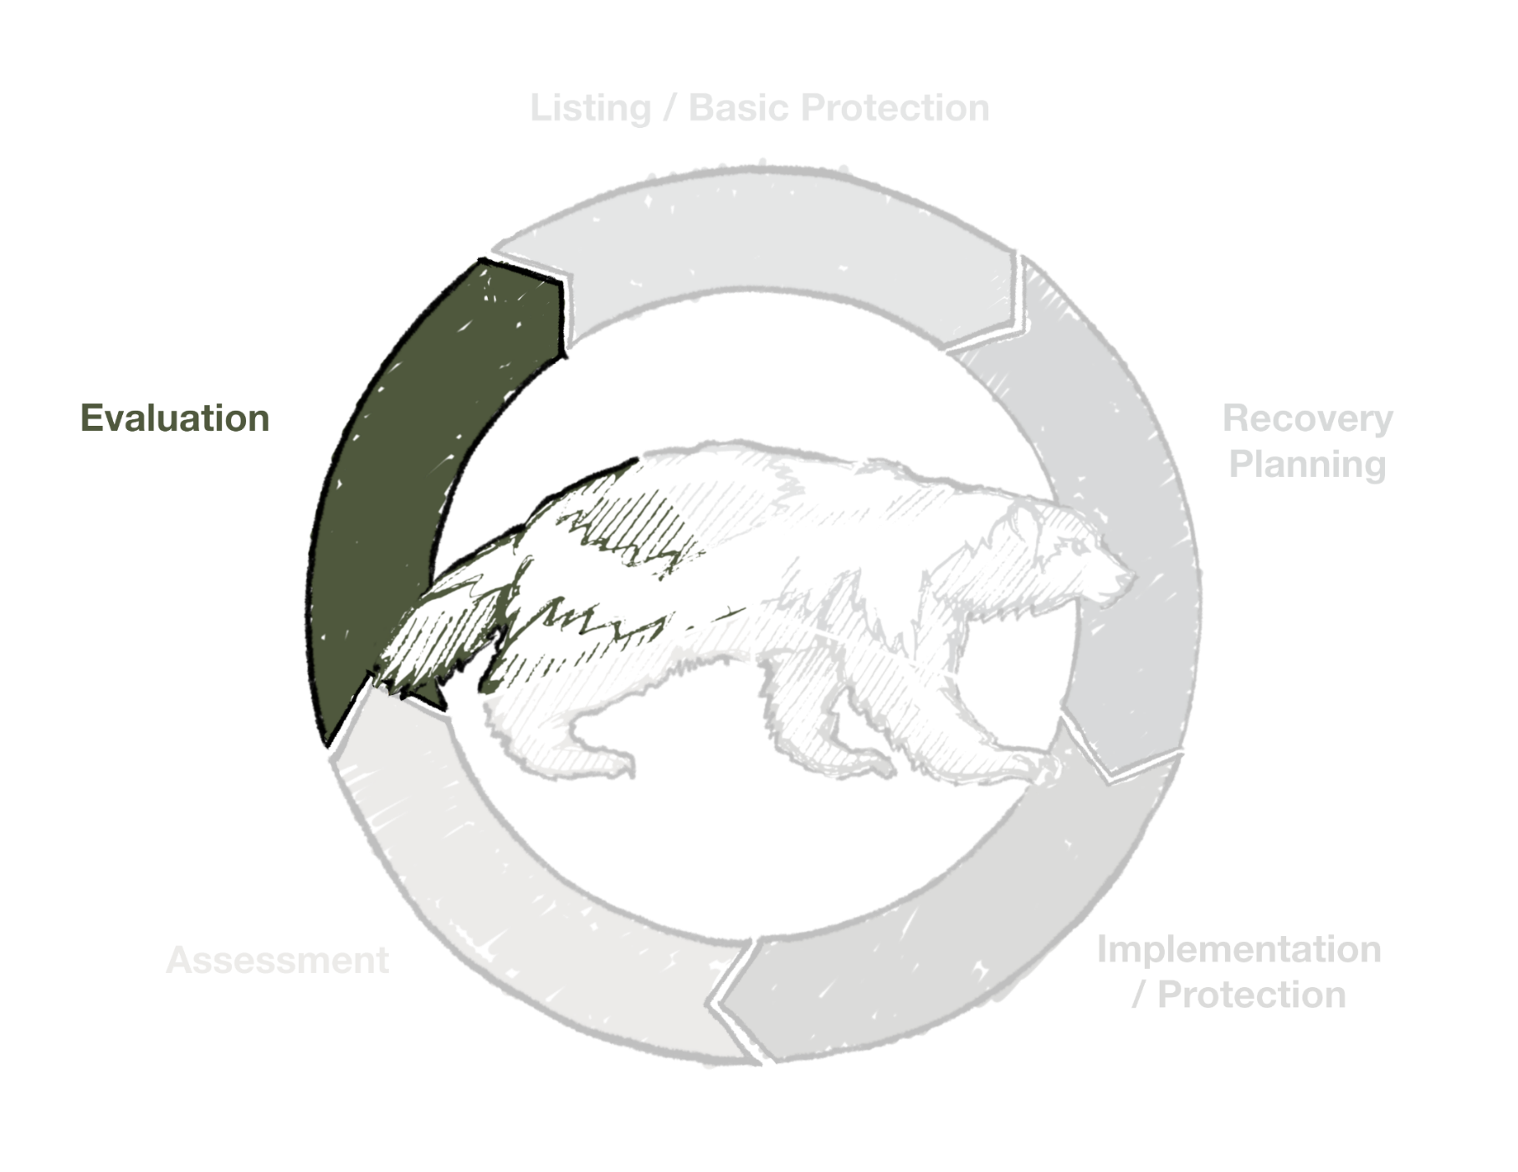
Species at Risk Act (SARA)
Assessment
Evaluation

Slide 8

Assessment
Done by COSEWIC = Committee on the Status of Endangered Wildlife in Canada
  Independent, non-government committee
  Considers already-published scientific and Indigenous Traditional Knowledge
COSEWIC assesses species and recommends a status to the federal government

Slide 9
COSEWIC Assessment for Wolverine
1982
  One population designated Special Concern
1989
    Western population and Eastern population
    Eastern population was designated Endangered
2014
  One population designated Special Concern

Slide 10
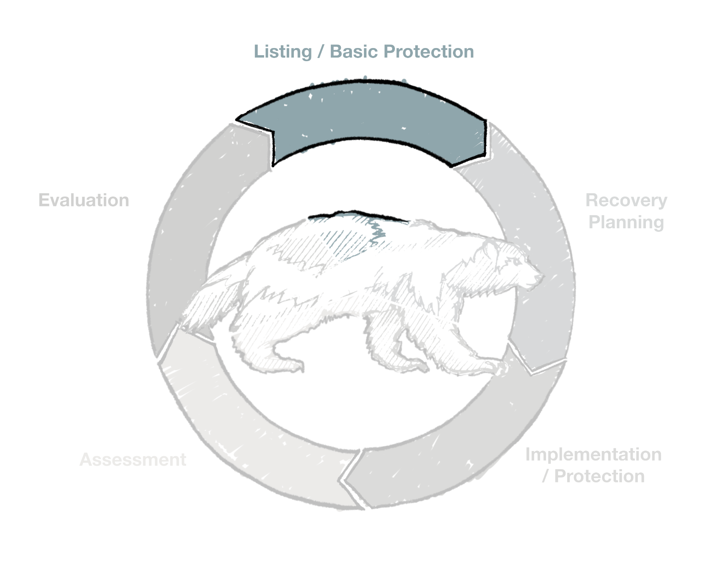
Species at Risk Act
Assessment
Evaluation

Slide 11
Listing
Consultation
Federal government consults with communities, Wildlife Management boards and Indigenous organizations to gather input on whether to list the species
Recommendation
Federal Environment Minister takes all input into account and makes a recommendation to federal cabinet
Decision
Federal cabinet decides whether to list the species
When a species is assessed at risk by COSEWIC:
Wolverine was listed special concerned under the Species at Risk Act in 2018

Slide 12
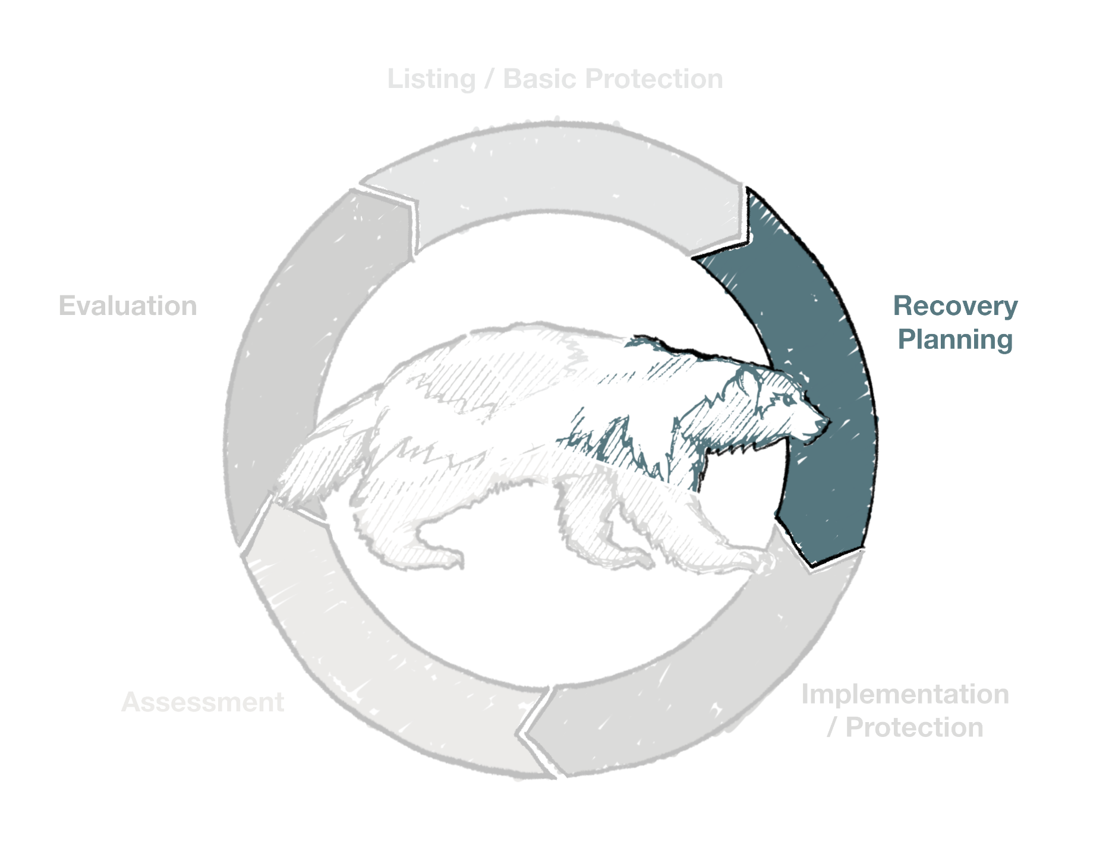
Species at Risk Act
Assessment
Evaluation

Slide 13
Recovery Planning
Recovery documents are required after SARA-listing
    Coordinated approach across Canada:
    E.g. wide-ranging species
    Developed cooperatively with all key partners:
    Communities, organizations, governments
    HTOs, WMBs, Indigenous Organizations, etc.

Slide 14



Recovery Planning
2016: Recovery Strategy for the wolverine, eastern population
Management Plan
Recovery Strategy
Action Plan
Extirpated ✓
Endangered ✓
Threatened✓
Special
Concern ✓
Broad Recovery Goals
Critical Habitat and Broad Recovery Goals
Specific recovery actions
Management Plan
    Timelines for Recovery Documents:
    Endangered 1 year, Threatened 2 years, Special Concern 3 years

Slide 15

Management Plans
Species Information
  Description, needs of species, distribution
Threats
  Description of threats
Population and Distribution Objectives
  Objectives, timelines
Broad Strategies and General Approaches to Meet Objectives
  Actions underway, actions, priorities
Measuring Progress
Management Plan

Slide 16
Questions?
GNWT

Slide 17
Part 2: Population, Distribution, and Range

Slide 18
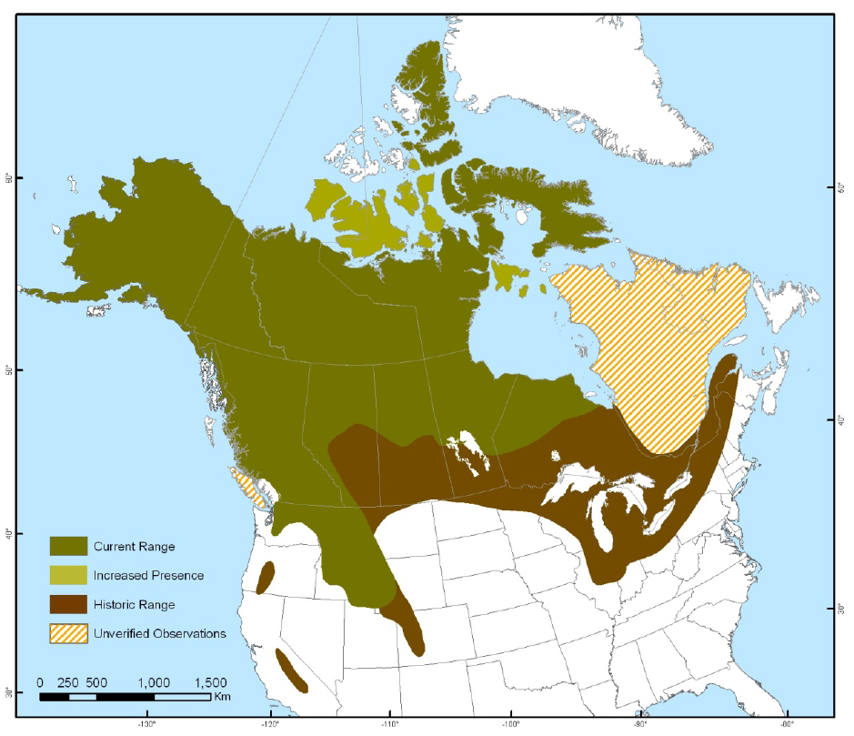
Wolverine Range in Canada
2019: 2 verified observations in Nunavik (Ivujivik and Salluit). Data provided by the government of Quebec.

Slide 19
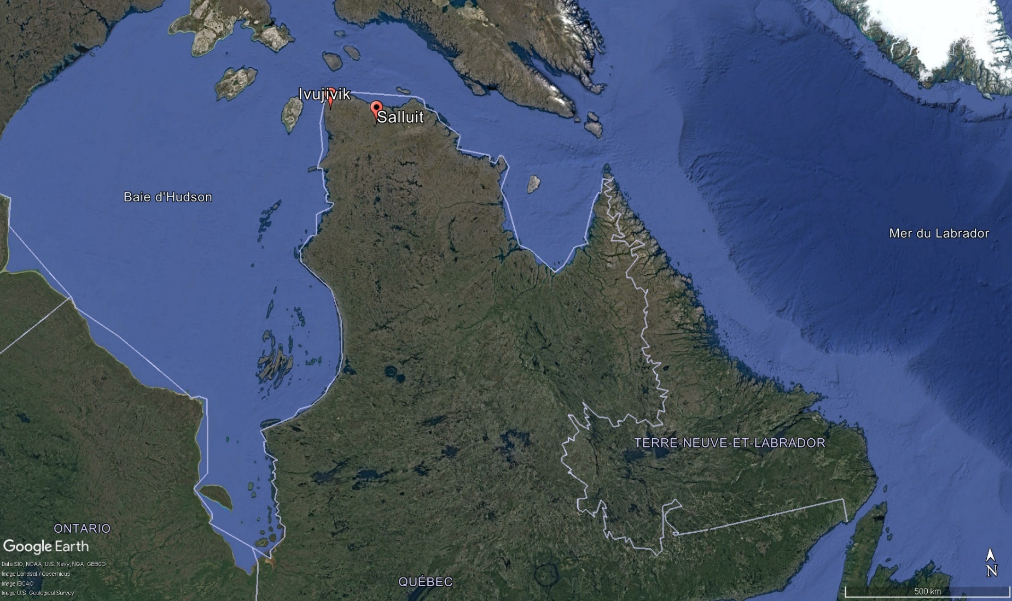

Slide 20
Population
Population estimated at 10,000 mature individuals and between 15,000 and 21,000 total individuals
Population Trends
  Potential declines in southern parts of their range
  Expansion in the NT, NU and ON
  Quebec: Only 2 confirmed + many unverified observations since 1980.

Slide 21
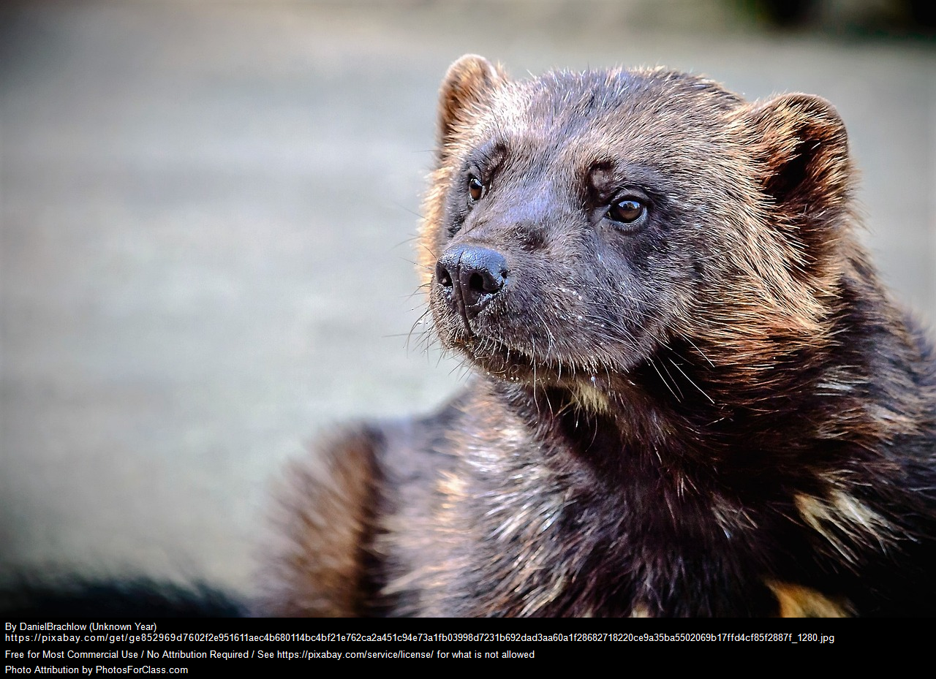
Are you seeing Wolverine in your area?

Slide 22
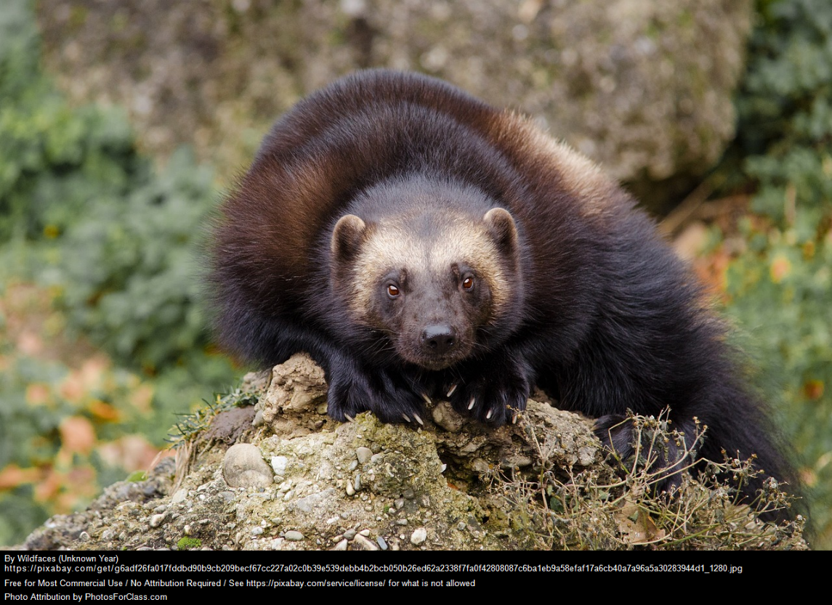
Moving Forward
Continue open communication with partners throughout the development of the management plan

Slide 23
Questions?
GNWT

Slide 24
For More Information…
If you have questions, or would like to receive more information, please contact us:
Marie-Hélène Dickey
Marie-Helene.Dickey@ec.gc.ca
Indigenous Coordination
and Consultation Officer
CWS Quebec Region
Thierry Calvé
Thierry.calve@ec.gc.ca
Species at Risk Biologist
CWS Quebec Region
Species at risk public registry
www.canada.ca/en/environment-climate-change/services/species-risk-public-registry.html

